Slide 1






From raw to refined: learn to get more out of your data with MS²Rescore
Robbe Devreese & Robbin Bouwmeester
@ FPS Youth Club Days 02/04/2025

Slide 2
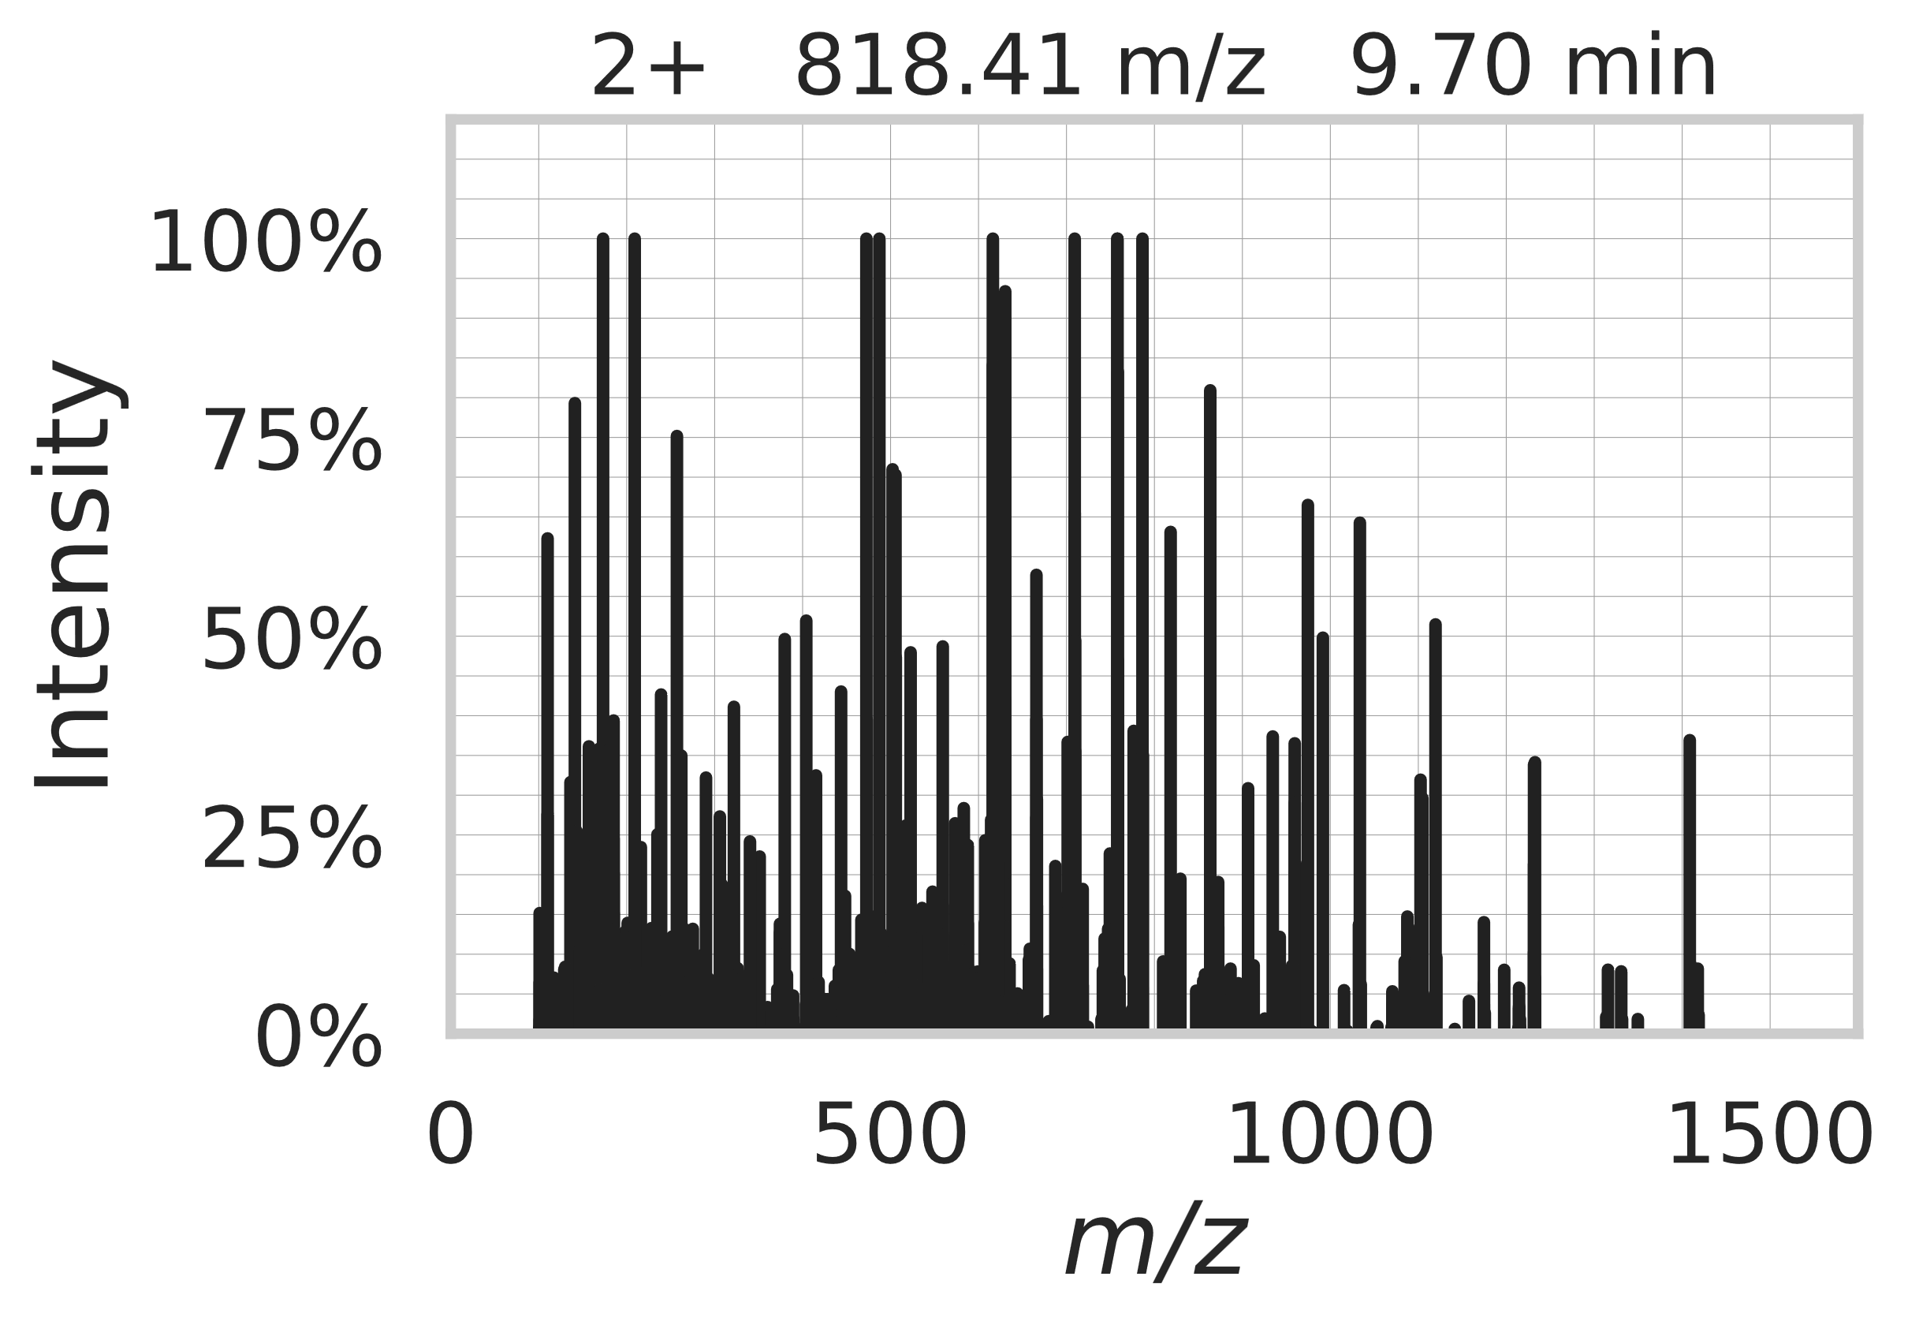
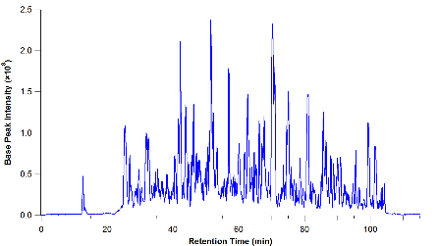
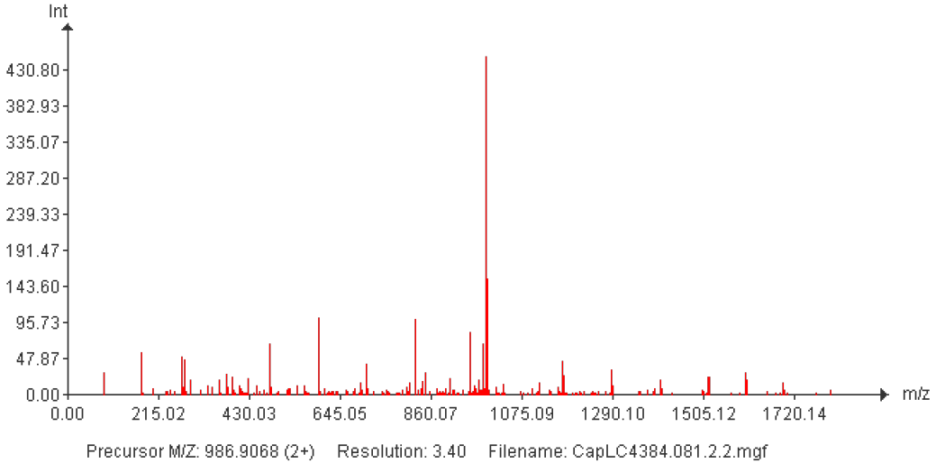
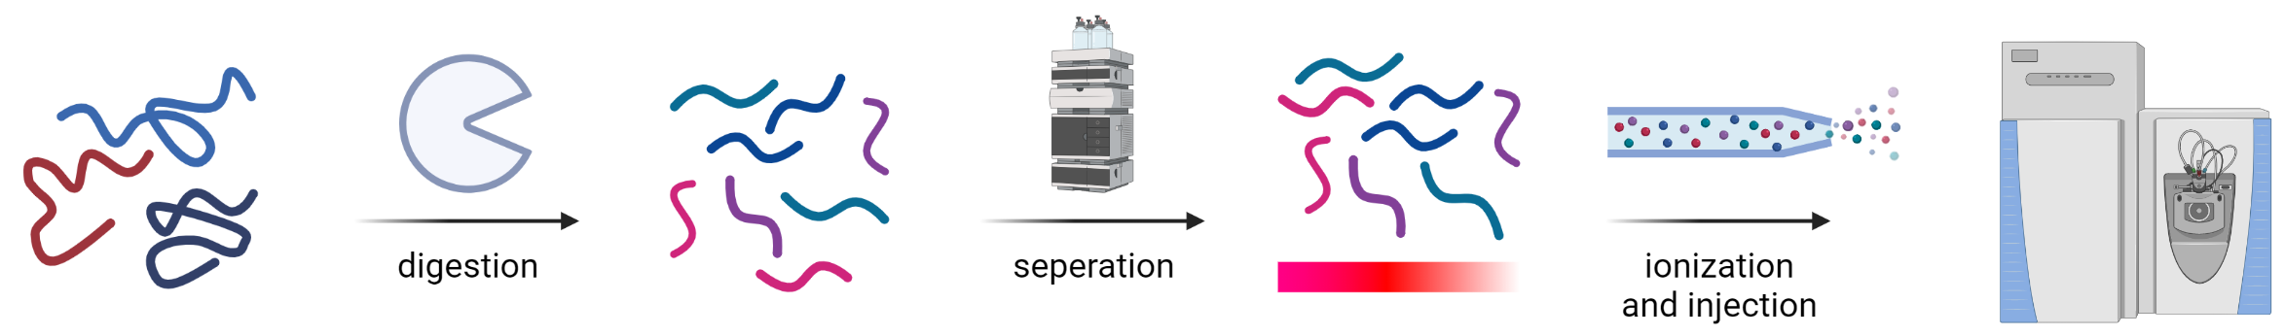
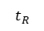

MS-based proteomics: from data to identification & quantification
experimental
HPYLEDR
LC
TIMS
MS scan
fragmentation
GDLVLFDR
AAAAGSLDK
$$t_{D}$$
peptides
chromatogram
mobilogram
MS1
MS2
Identification
Quantification
+
$$t_{R}$$

Slide 3
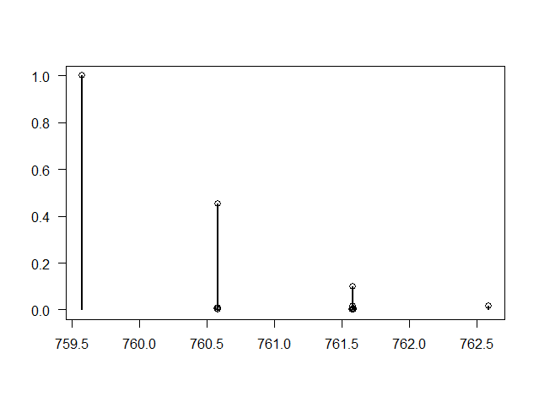
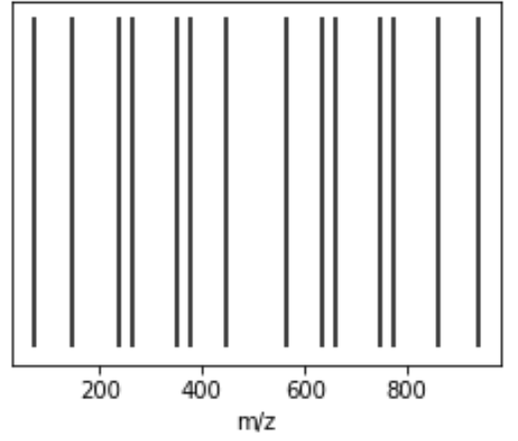
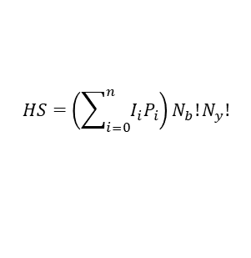
MS-based proteomics: from data to identification & quantification
experimental
HPYLEDR
LC
TIMS
MS scan
fragmentation
GDLVLFDR
AAAAGSLDK
$$t_{D}$$
peptides
chromatogram
mobilogram
MS1
MS2
Scoring function
Identification
Quantification
$$HS=\left(\sum_{i=0}^{n}{I_{i}P_{i}}\right)N_{b}!N_{y}!$$
+
in silico
$$t_{R}$$
m/z
calculate
mass
in silico
MS/MS
m/z
theoretical
spectra
fasta
database
precursor mass
(and isotopic distribution)

Slide 4
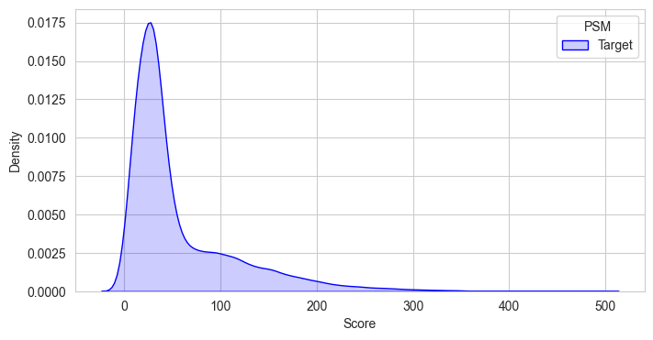
A better separation between true and false, leads to a higher sensitivity (and specificity)
Most-likely false
Most-likely true

Slide 5
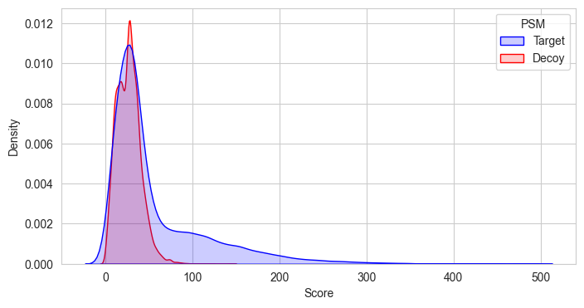
A better separation between true and false, leads to a higher sensitivity (and specificity)
Model the false target distribution

Slide 6
Search engine scores are used to separate true from false matches
1% estimated FDR
Accepted as true

Slide 7
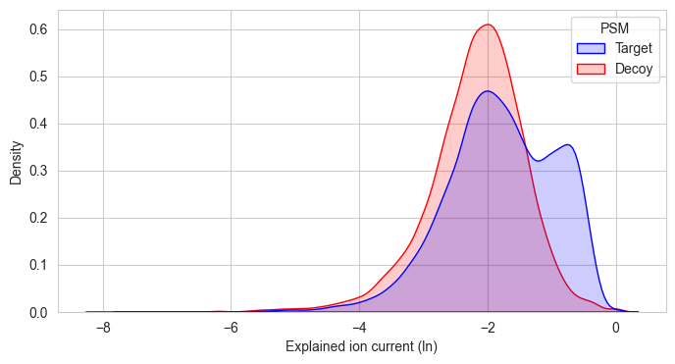
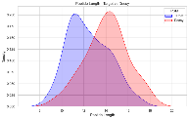
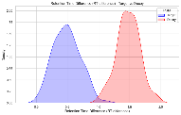
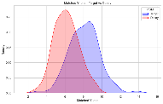
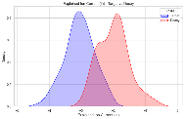
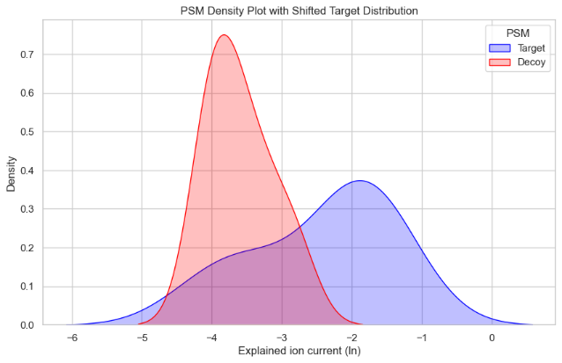
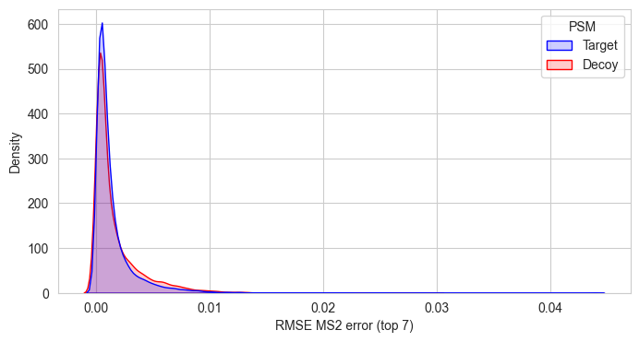
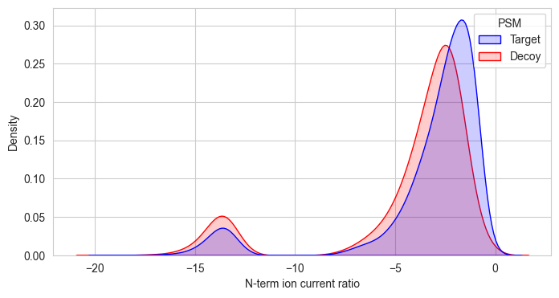
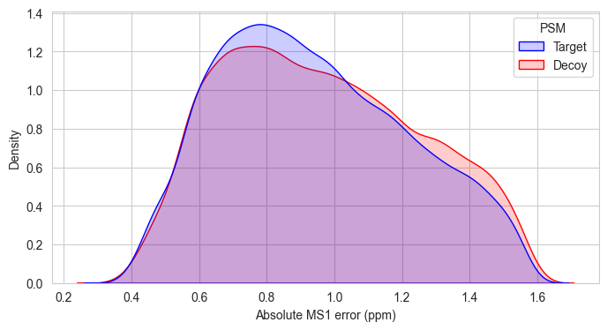
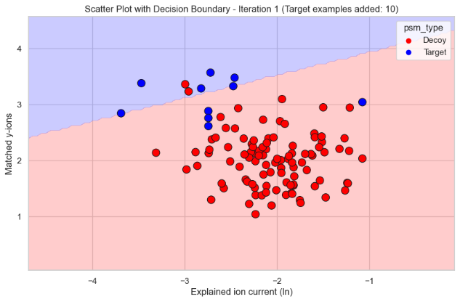
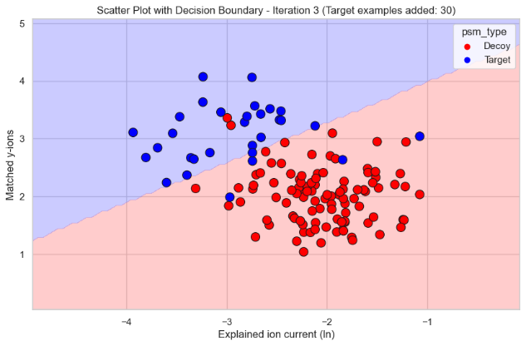
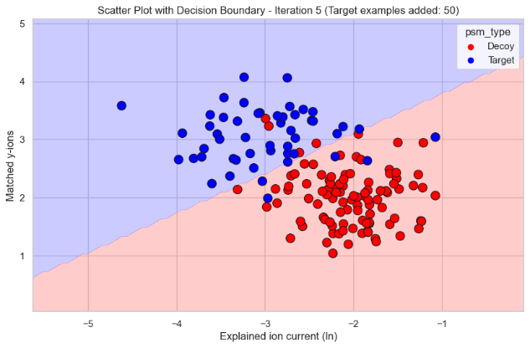
Annotated spectra contain many more dimensions (aka features)
high-dimensional scoring
tailoring the weight to specific experiments or runs
Semi-supervised classification of targets and decoys on high-dimensional data for a specific dataset
Iteration
Iteration

Slide 8

Mass spectrometry-based proteomics recap
experimental
HPYLEDR
LC
TIMS
MS scan
fragmentation
GDLVLFDR
AAAAGSLDK
$$t_{D}$$
peptides
chromatogram
mobilogram
MS1
MS2
Scoring function
Identification
Quantification
+
in silico
$$t_{R}$$
m/z
calculate
mass
in silico
MS/MS
m/z
theoretical
spectra
fasta
database
precursor mass
(and isotopic distribution)

Slide 9
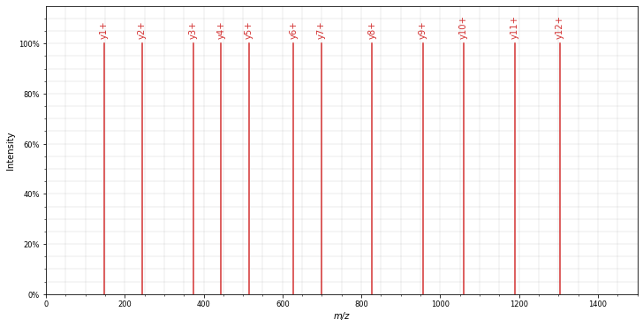
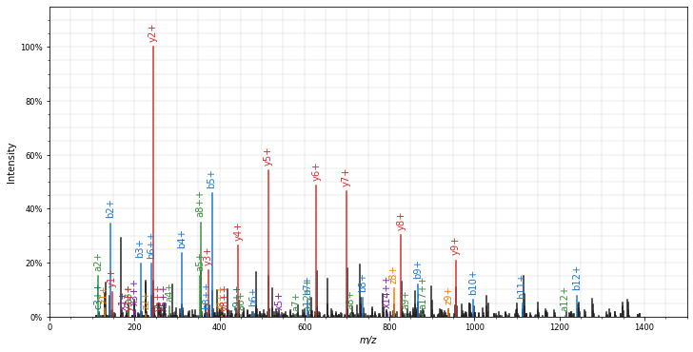
Machine learning can also add new dimensions to PSM scoring
intensity
intensity
m/z
m/z
theoretical spectrum
observed spectrum
9

Slide 10
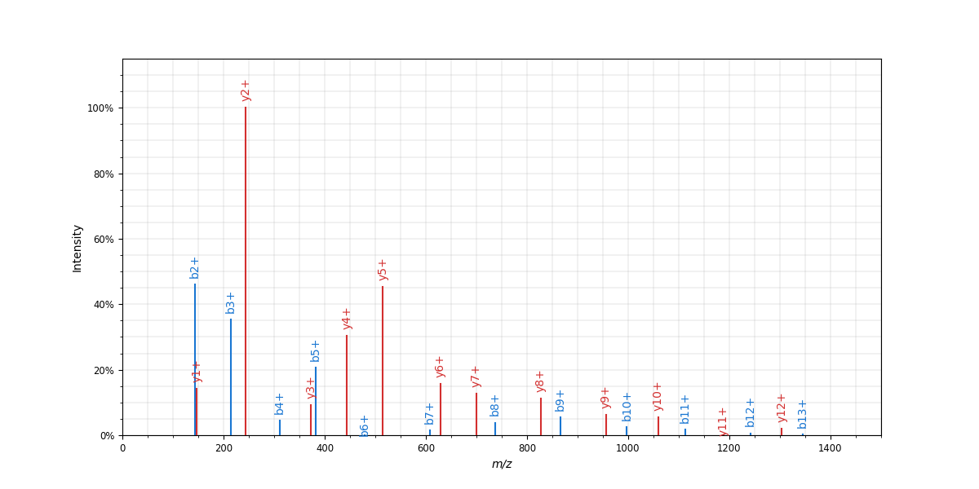

Machine learning can also add new dimensions to PSM scoring
intensity
intensity
m/z
m/z
MS²PIP-predicted spectrum
observed spectrum
10

Slide 11
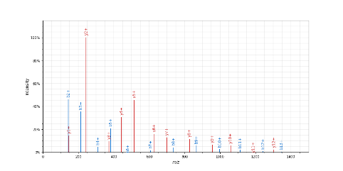





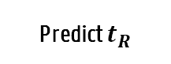

A learned scoring function instead of a preset equation
experimental
HPYLEDR
LC
TIMS
MS scan
fragmentation
GDLVLFDR
AAAAGSLDK
$$t_{D}$$
peptides
chromatogram
mobilogram
MS1
MS2
Scoring function
Identification
Quantification
+
in silico
$$t_{R}$$
m/z
Predict $t_{R}$
m/z
Predict mobility
m/z
calculate
mass
in silico
MS/MS
m/z
$$t_{R}$$
$$t_{R}$$
$$t_{R}$$
$$t_{D}$$
$$t_{D}$$
Int.
m/z
theoretical
spectra
fasta
database
precursor mass
(and isotopic distribution)

Slide 12
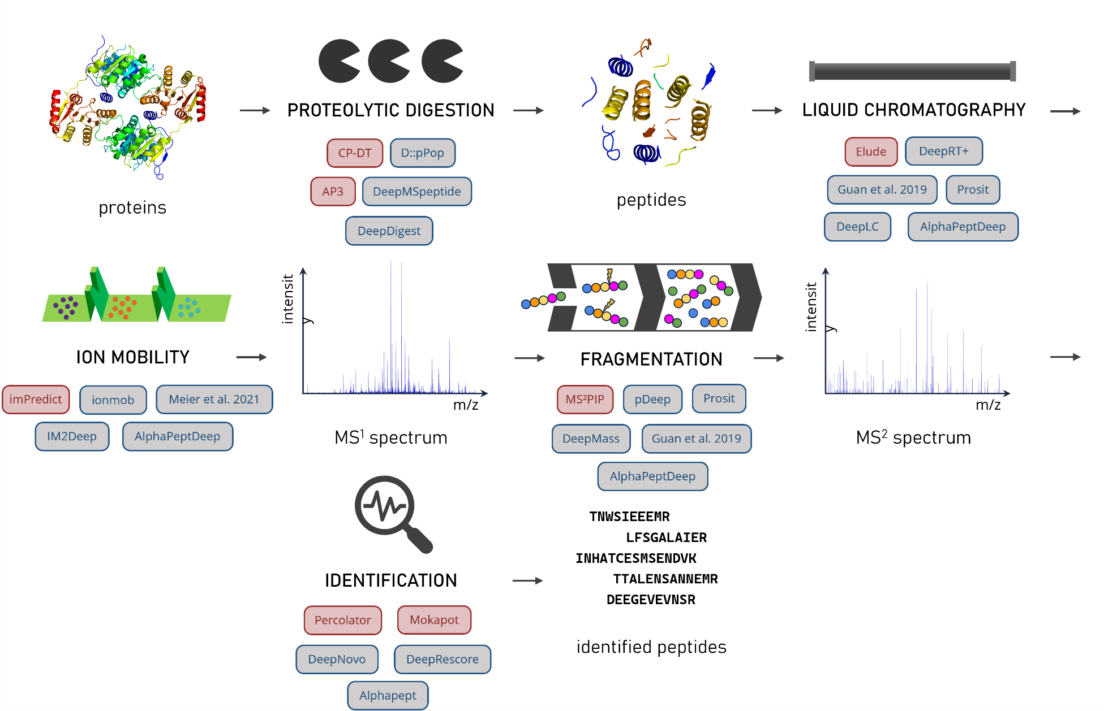
Nearly the whole LC-IM-MS workflow can be predicted
Adapted from Robbin Bouwmeester* & Ralf Gabriels* et al. (2020) Proteomics. doi:10.1002/pmic.201900351
Notes:
Bring more information into the ID step

Slide 13
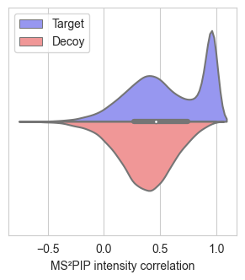
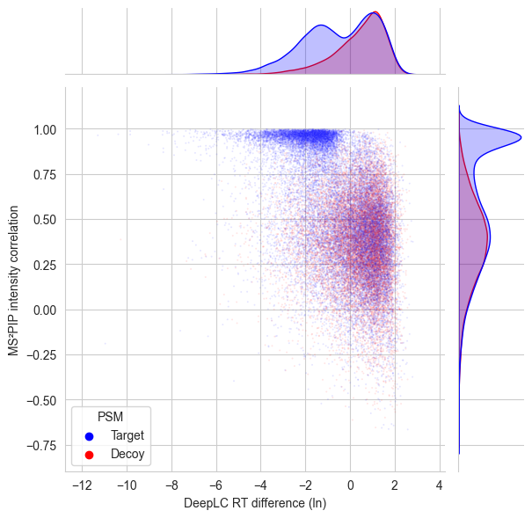

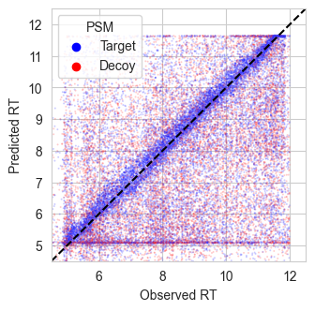
Orthogonality in predicted features leads to an improved separation between true and false PSMs
+
=

Slide 14
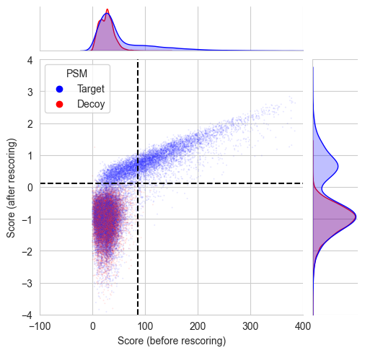
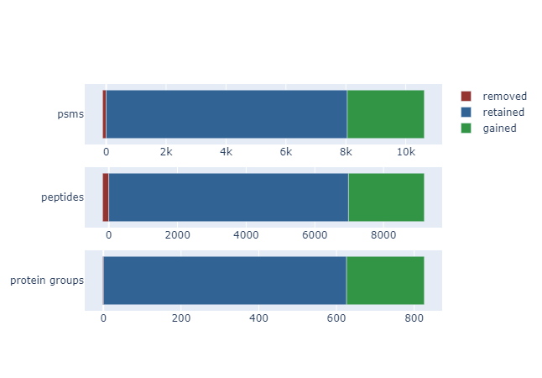
Data-driven rescoring with predicted behavior results in sensitive and accurate peptide identification
Newly added PSMs

Slide 15
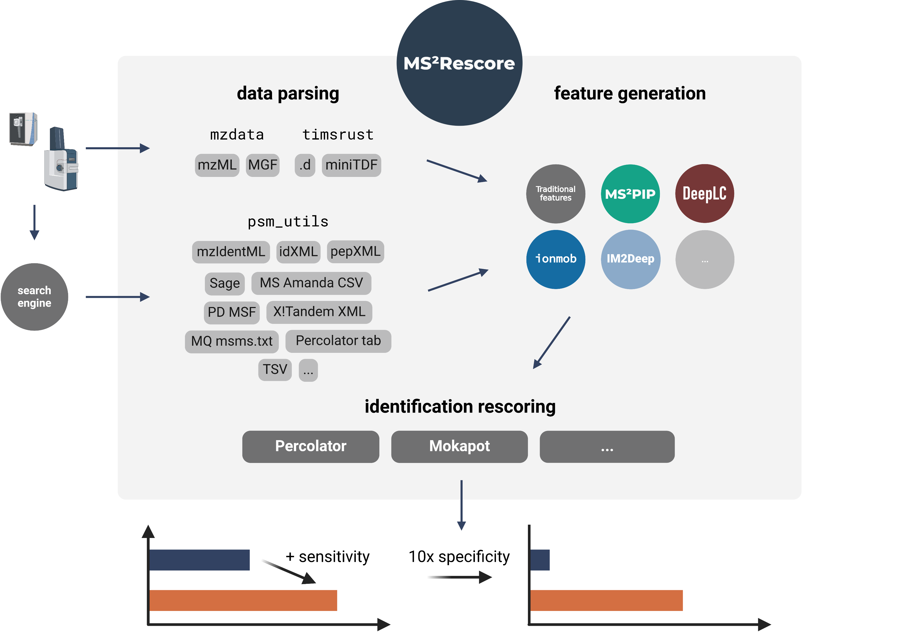
MS²Rescore combines the full workflow and is available with a Graphical User Interface & Python package

Slide 16
From raw to refined: learn to get more out of your data with MS²Rescore
Robbe Devreese & Robbin Bouwmeester
@ FPS Youth Club Days 02/04/2025

Slide 17

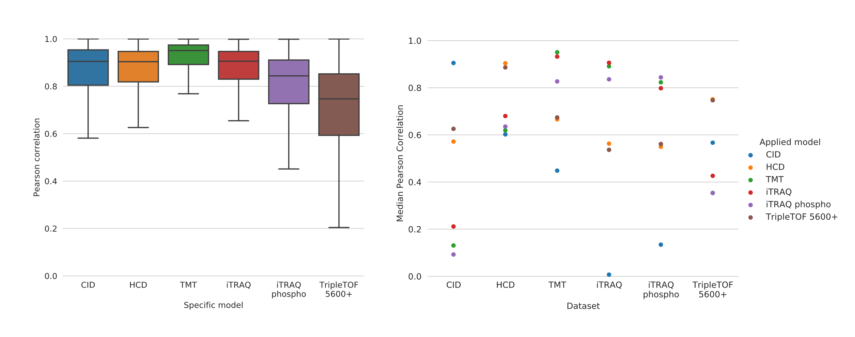
Different fragmentation methods require specialized MS²PIP models
Notes:
We, and others have in the past shown that different fragmentation methods, for example due to different instrumentation, can heavily alter peptide MS2 spectra. Which means that a MS2PIP model that is not explicitly trained on fragmentation spectra acquired by the method you’re trying to predict spectra for will show suboptimal performance. For example if you use a model trained on CID spectra to predict spectra acquired from TMT spectra, your gonna get suboptimal predictions. So this means for many different instruments and labelling methods, we have trained distinct MS2PIP models that the user can use to make sure that they get good predictions for their specific data.

Slide 18

New timsTOF MS²PIP model shows excellent performance
Intensity correlation (tryptic)
Intensity variation (tryptic)
Intensity correlation (elastase)
Intensity variation (elastase)
correlation
HCD
timsTOF
HCD
timsTOF
Intensity correlation (immune class I)
Intensity variation (immune class I)
Intensity correlation (immune class II)
Intensity variation (immune class II)
correlation
HCD
timsTOF
HCD
timsTOF
Notes:
For example for our latest MS2PIP model, which was specifically trained on timsTOF data, we combined four publicly available dataset to train the model
Each dataset contained a different type of peptides, we had classic tryptic peptides, elastase cleaved peptides, which are generally a lot more varying in length. And then we also have both class I and II immunopeptides, which do not follow a specific cleavage pattern. Each of these datasets were combined and split into a stratified train-test split. And here you can see the performance of the newly trained model on the evaluation sets of each different class of peptides, specifically the Pearson correlation between the observed and predicted peak intensities, and we can see excellent performance across the line, especially compared with the performance of the original HCD MS2PIP model on these test sets. So on the right of each evaluation you can see boxplots that represent the inherent intensity variation of the peptides present in the datasets. So this is calculated by correlating the observed intensities for spectra coming from the same precursor, and this provides an estimate of the best possible accuracy that can be achieved with prediction models. And as you can see our test performance is very close to this estimated upper limit of performance, which means that our models perform very well.

Slide 19




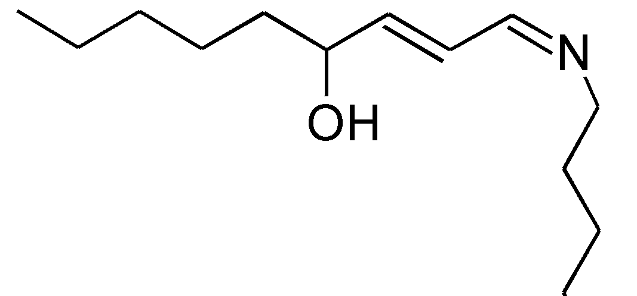
Current state of the art models are limited in their ability to encode modified peptides
DeepRT+
DeepCollisionalCrossSection
HNE
HNE
AAAAGSLDK
AAAAGSLDK
Amino acid | A | A | … | D | K
Position | 1 | 2 |  | 8 | 9
Ala | 1 | 1 | … | 0 | 0
Cys | 0 | 0 | … | 0 | 0
Glu | 0 | 0 | … | 0 | 0
… | 0 | 0 | … | 0 | 0
Asp | 0 | 0 | … | 1 | 0
Lys | 0 | 0 | … | 0 | 1
Amino acid | A | A | … | D | K
Position | 1 | 2 |  | 8 | 9
Carbon | 3 | 3 | … | 4 | 6 15
Hydrogen | 7 | 7 | … | 7 | 14 30
Nitrogen | 1 | 1 | … | 1 | 2
… |  |  | …
Oxygen | 1 | 1 | … | 3 | 1 2
Sulfur | 0 | 0 | … | 0 | 0
Notes:
Two other dimensions for which we can use rescoring features to boost the identifications in your data are retention time and ion mobility.
And of course we also have two models that predict the retention time and ion mobility of peptides.
These models are called DeepLC and IM2Deep. And in terms of training procedure and architecture they are very similar.
And the nice thing about both DeepLC and IM2Deep is that they allow for the prediction of retention time and ion mobility of any modified peptide, even if that modification was never included in the training set of the model.
Older models are usually trained on one-hot encodings of peptides, as you can see on the left, where at each position in the peptide, the correct amino acid gets denoted with a 1 and the rest with a zero, so at every position you get a vector of length 20.
And this of course works very well, but if you encounter a modification, then you cannot encode it easily, so you would have to add a row to this matrix. But there are very many different kinds of modifications so you would have to add a row to the matrix for each one of them, and if you do that you need a lot of training data for each modification and that data is simply not available.
So the approach that was taken for first DeepLC and later IM2Deep is the following: instead of encoding the peptide on the amino acid level, we encode the peptide on the atomic composition level, as you can see on the right.
So for example alanine, instead just writing a 1 in the row where the alanines are encoded, we instead encode it by the number of carbons, hydrogens, nitrogens and so on that alanine contains.
And so if we encounter an amino acid, we simply add the atoms of that modification to the atoms of the amino acid on which it occurs.
And in this way DeepLC and IM2Deep are able to generalize their predictions beyond the modifications that were present in the training data.

Slide 20
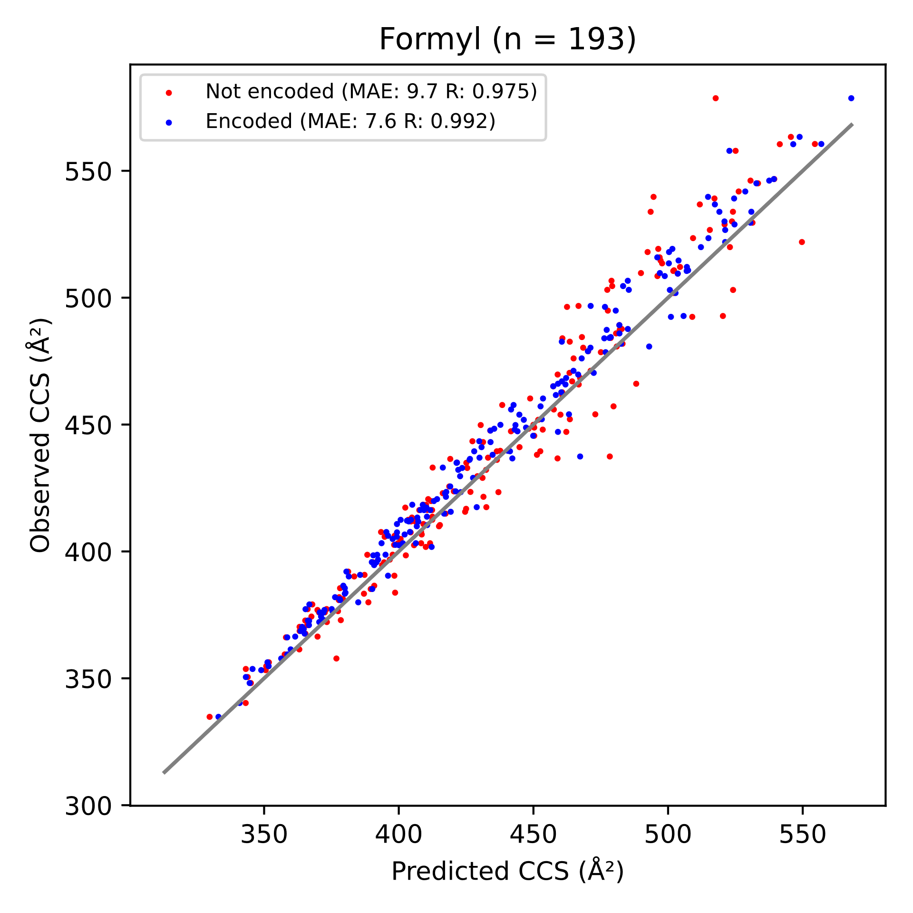
Encoding on the atomic level allows CCS prediction for peptides with modifications not seen during training
DMAQSIY[Formyl]R
Y[Formyl]GM[Oxidation]VAQVTQTLK
Y[Formyl]EATSVQQK
DMAQSIYR
YGM[Oxidation]VAQVTQTLK
YEATSVQQK
Copy test set (Formyl not Encoded)
Based on Formyl
VNALKNLQVK
DEPAM[Oxidation]VYTGDHK[Crotonyl]
LTSLNVK[Crotonyl]YNNDK
DMAQSIY[Formyl]R
Y[Formyl]GM[Oxidation]VAQVTQTLK
Y[Formyl]EATSVQQK
Original test set (Formyl Encoded)
Notes:
The way we confirm and test this ability is the following. We have our entire dataset, which contains all kinds of peptides with a bunch of modifications. We had 21 in total present. And for each of these 21 modifications, we take out all the peptides carrying a specific modification, for example formylation and use those as a test set. The rest of the peptides, that do not carry this modification, are used as a training set. So this is done for each of the modifications in the total dataset, so in total, 21 different models are trained. Then for each of the 21 models, the following testing procedure is set up. The test set, which contains all of the peptides carrying the modification that was not seen by the model, is duplicated. Once, the peptides are not encoded with the modification for prediction, so effectively, ignored. And for the other test set, the unseen modification is correctly encoded. And then what we observe is that the performance of the model that did not observe the modification, in this case formylation, has a higher accuracy when the modification is correctly encoded for prediction, over the baseline where it is simply ignored. What this means is that the model correctly interpreted the added atoms of the modification and it’s effect on CCS, even though it never actually saw that specific modification. And it’s important to note that not only the Mean absolute error decreases, which means that the shift caused by the modification is correctly interpreted, but also the Pearson’s correlation, which means that the context in which the added modifications found itself also contributed to the prediction.

Slide 21
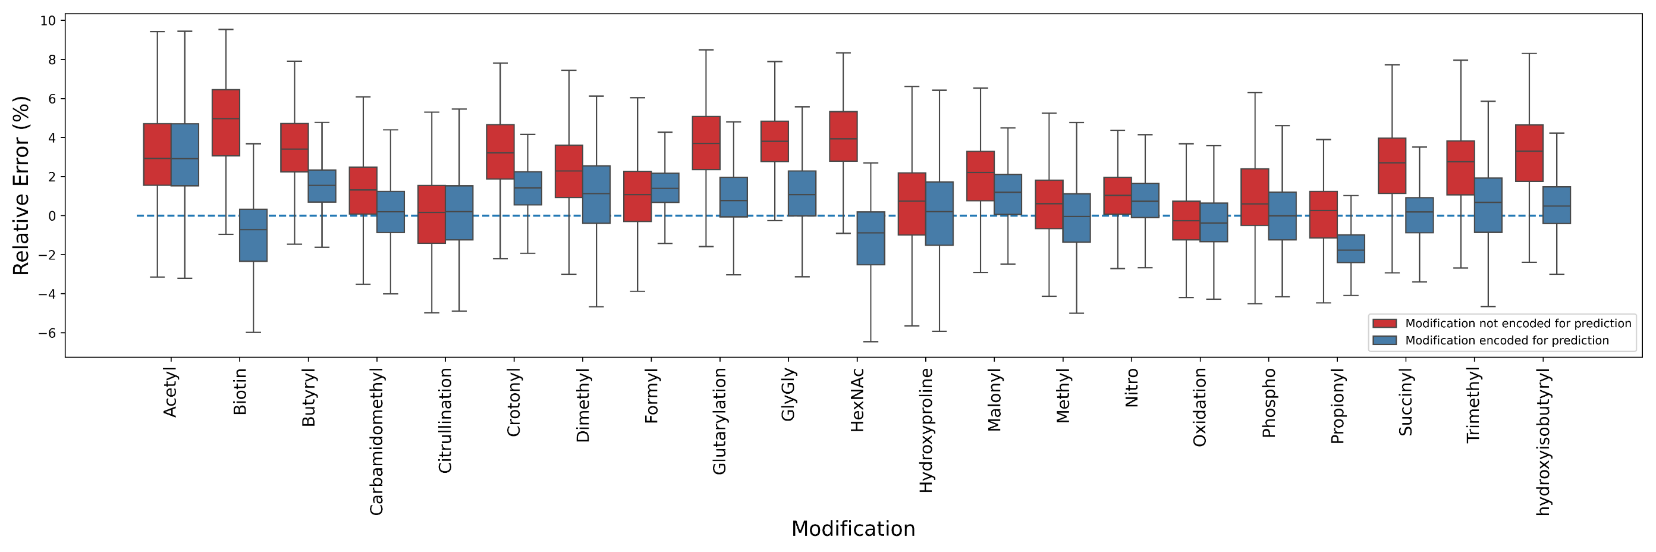
IM2Deep accurately predicts CCS for modified peptidoforms…
Relative error (%)
Modification not encoded for prediction
Modification encoded for prediction
Modification
Notes:
And if we repeat this evaluation for all 21 modifications present in our data, we see that this is observed for almost all modifications, so the median error is almost always closer to zero when the modification is encoded versus when it is not. So in conclusion we can say that IM2Deep can accurately predict CCS values for peptides that carry any modification, even if it was never observed by the model.

Slide 22
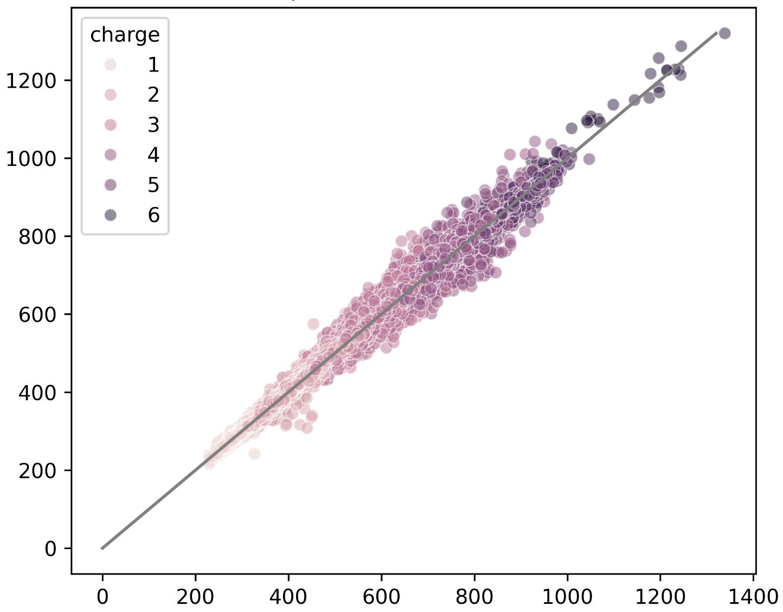
…across many charge states
Charge
+1
+2
+3
+4
+5
+6
Observed CCS (Å²)
Overall performance
MAE: 6.26 Å²
MRE: 0.91%
R: 0.996
Predicted CCS (Å²)
Notes:
Another advantage of IM2Deep is that it was trained on a very wide range of charge states, more than any other available CCS predictor.

Slide 23
MS²Rescore combines the full workflow and is available with a Graphical User Interface & Python package

Slide 24
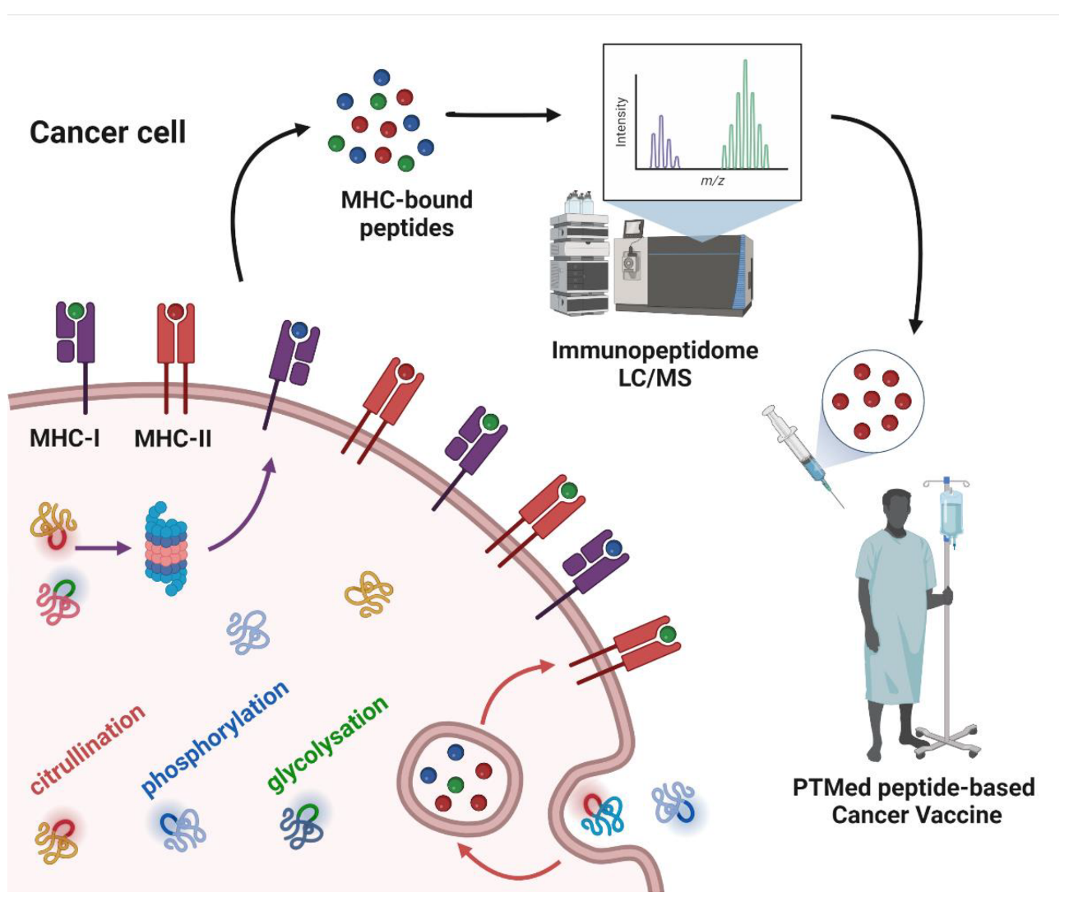


TIMSRescore in immunopeptidomics: Enabling the development of anti-cancer vaccines
random cleavage of proteins into peptides
peptides with low ionization and fragmentation efficiency
Patient-specific cancer vaccine
Image adapted from https://www.mdpi.com/2072-6694/14/20/4968
Notes:
Maybe a little explainer if you’re unfamiliar with the field of immunopeptidomics. So in immunopeptidomics, the goal is to identify antigens that are associated to the major histocompatibility complex, so in essence the peptides that are derived from either endogenous or exogenous proteins, that get recognized by T cells and trigger an immune response. The way these peptides are isolated is usually via immuno-affinity precipitation equipped with MHC antibodies, and then they get analyzed with mass spectrometry. This is a really booming field that is able to make very nice contributions to vaccine development for infectious disease, but also for for example patient-specific cancer vaccines. However there are some complications to the data-analysis of immunopeptidomics. Firstly, immunopeptides are not cleaved by any protease prior to mass spec analysis, which means that they do not follow a specific cleavage pattern. This means that the database that you want to search your spectra against, cannot be pre-cleaved based on any protease cleavage rules, which massively increases your search space. Secondly, immunopeptides often have very low ionization and fragmentation efficiency, which means that the quality of your spectra are generally quite a bit lower than let’s say, normal tryptic digest peptides. And these two factors lead to the fact that immunopeptidomics data often leads to a very low identification rate and a very low number of confidently identified peptides.
So this is a prime usecase for MSRescore to see if by using data-driven rescoring, we can increase this identification rate.

Slide 25
MS²Rescore in immunopeptidomics: up to 71% increase in spectrum identification rate
Notes:
And, as you can see here, we do see an enormous increase in identification rate for immunopeptidomics data. At 1% FDR we have a more than 70% increase in ID rate, and at 0.1% we almost triple the number of identified spectra in class I immunopeptides. I should say here that a big reason the benefit of TIMSRescore is so huge here, is that the amount of class I immunopeptidomics data that was simultaneously rescored here with TIMSRescore was really really large. And so what we usually observe is that, the higher the number of identifications made by the search engine to begin with, the larger the benefit of rescoring will be. So for example here we had about 750.000 PSMs identified by Sage prior to rescoring for the class I immunopeptides, and about 200.000 for the class 2 immunopeptides and so because much more information is provided to TIMSRescore for the class I immunopeptidomics, a much more sensitive rescoring will be possible, leading to a huge increasing in identifications.

Slide 26
MS²Rescore in immunopeptidomics: up to 69% increase in unique identified immunopeptides
Notes:
On the peptide level, we also see huge increases, so about 70% at 1% FDR, and at 0.1% FDR, we more than double the amount of peptides that are confidently identified.

Slide 27
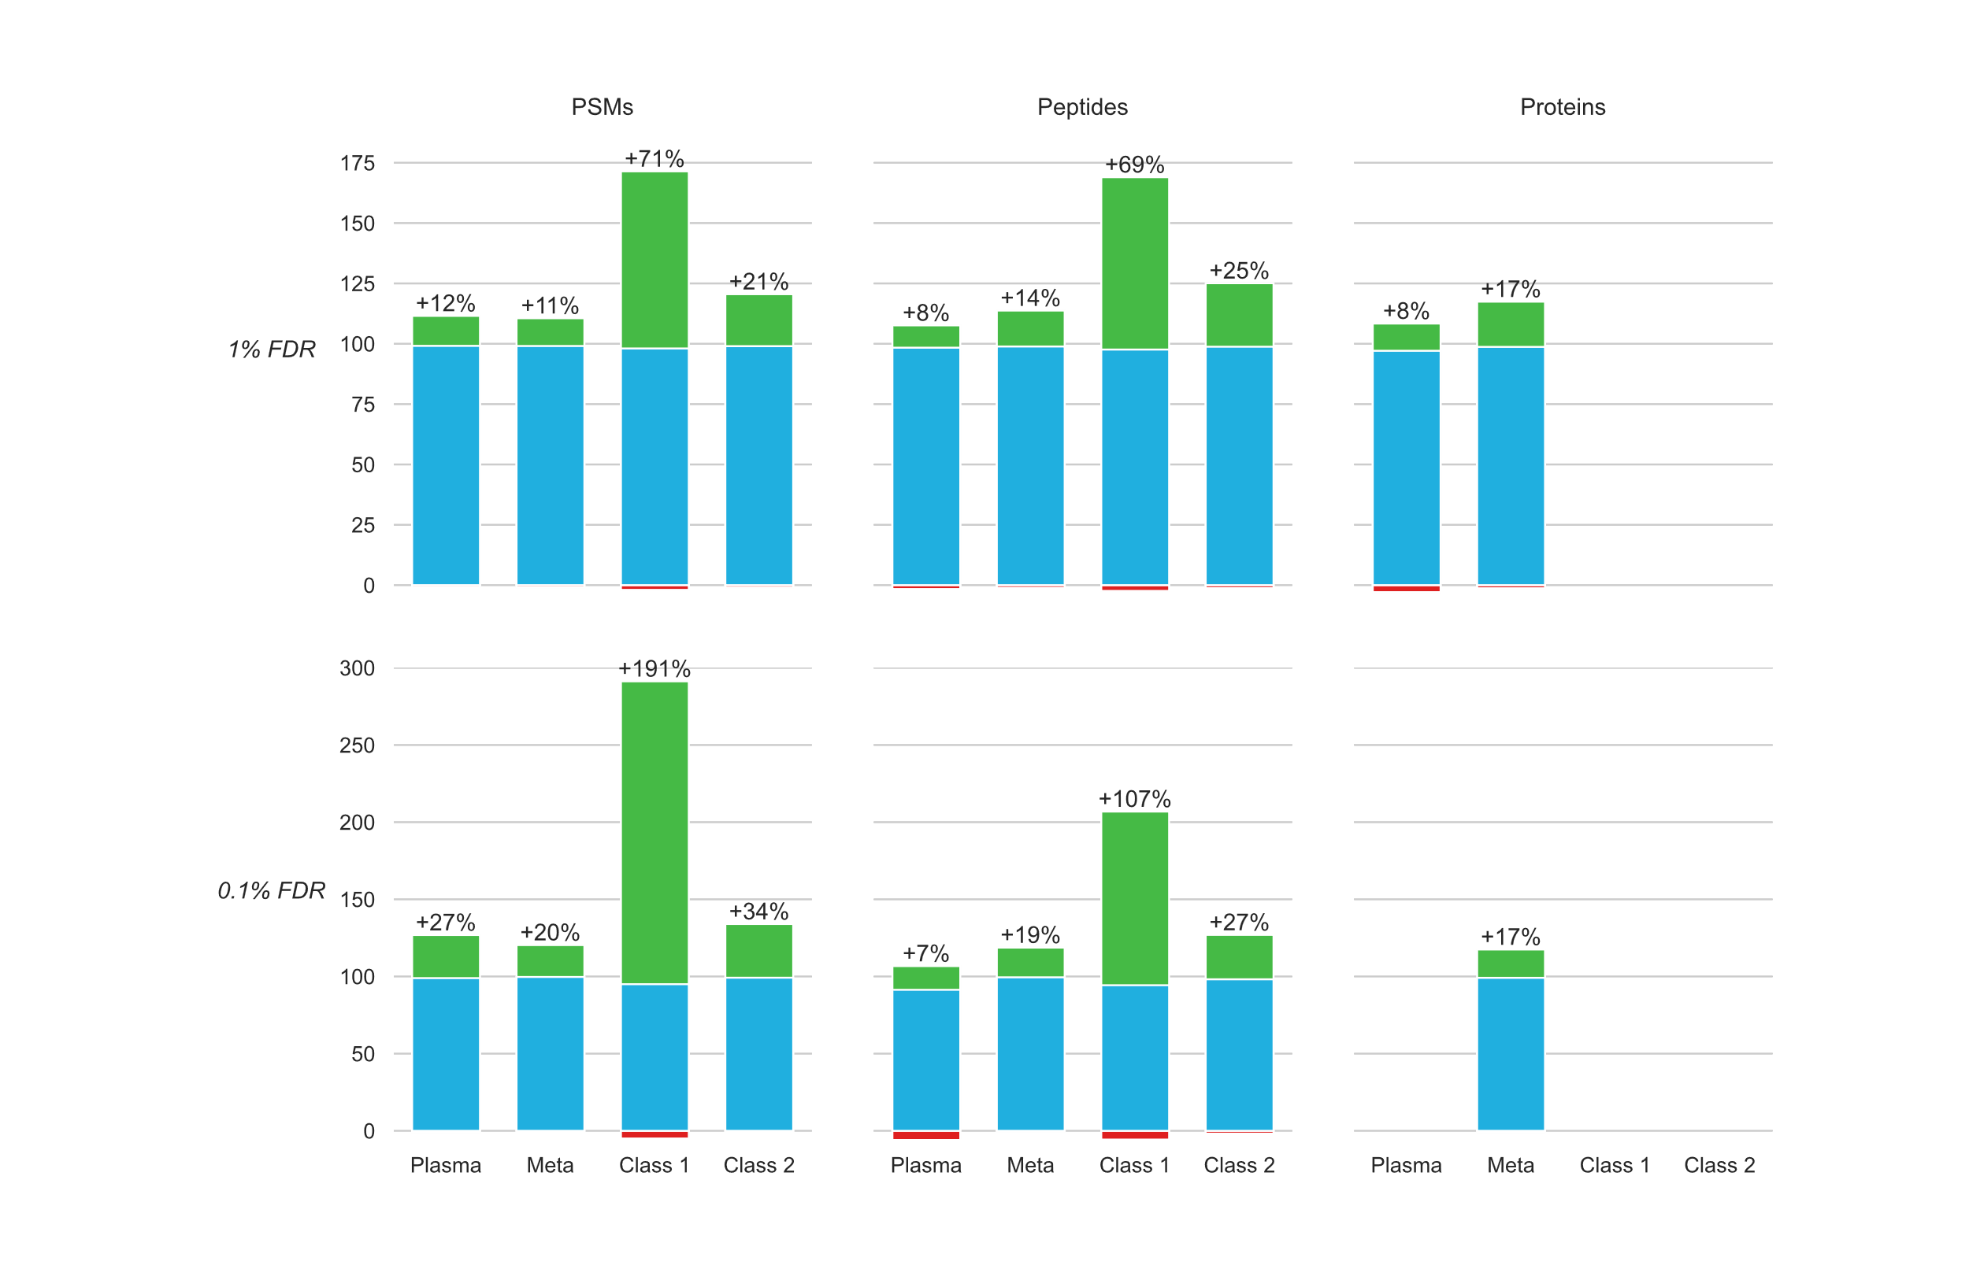
MS²Rescore in immunopeptidomics, plasma proteomics, metaproteomics…
Notes:
Of course, immunopeptidomics is not the only field that will benefit from rescoring. Other fields with challenges in data-analysis, for example plasma proteomics, where the dynamic range of protein abunances requires enormous sensitivity, and metaproteomics where the complexity of the large number of species that have closely related proteomes are present in the same samples. These are fields that often suffer from low identification rates and so just like immunopeptidomics, we can show that TIMSRescore for these datasets also has a huge advantage with many more PSMs, peptides and protein identifications. Again, the datasets rescored here are a lot smaller than the class I immunopeptidomics datasets so the increases maybe do not look as large in comparison but these are still very substantial increases in identifications.
And so in conclusion, by leveraging and combining the highly sensitive timsTOF instruments and the integration of AI, the potential for new discoveries and improvements in disease diagnosis and treatment is vast.

Slide 28


















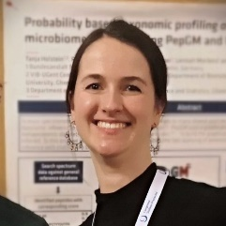




Alexander Kensert
Alireza Nameni
Arthur Declercq
Caroline Jachmann
Enrico Massignani
Harikrishnan Ramadasan
Jasper Zuallaert
Kevin Velghe
Lennart Martens
Lyudmila Kovalchuke
Natalia Tichshenko
Pathmanaban Ramasamy
Patricia Lefèvre
Pieter Verschaffelt
Ralf Gabriels
Toon Callens
Robbe Devreese
Many thanks to our
collaborators at Bruker:
Jonathan Krieger
George Rosenberger
Tharan Srikumar
Sander Willems
Dennis Trede
Robbin Bouwmeester
Tine Claeys
Sakina Bombaywala
Sam van Puyenbroeck
Sven Degroeve
Tanja Holstein
Tim Van Den Bossche
www.compomics.com
@CompOmics
Notes:
Thank you for joining us. We would like to thank our CompOmics group members back in Ghent. Also, special thanks go out to our collaborators at Bruker, not only for our fruitful collaboration on TIMSRescore but also for inviting us to come talk here.
Thank you.

Slide 29

https://github.com/compomics/Workshop_Grenoble_2025

Slide 30
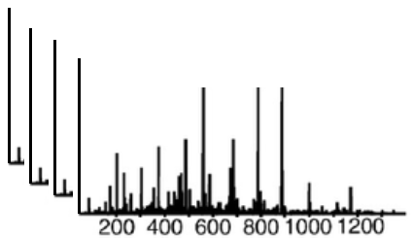
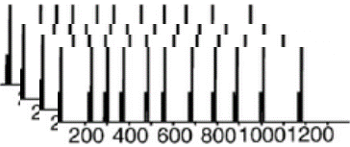
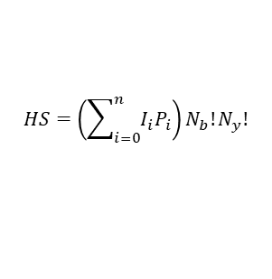
Proteomics search engines replicate the LC-MS steps in silico
Digestion
Detection
Identification
Proteins
Peptides
Spectra
$$HS=\left(\sum_{i=0}^{n}{I_{i}P_{i}}\right)N_{b}!N_{y}!$$
LPVWSQRNFK
>LPVGTSSGDSPKPDYKGATTVRDLTPENEWYVKEITGSTKTKVIKLNWQRSTVK
In silico digestion
>LPVGTSSGDSPK
>PDYKGATTVR
>DLTPENEWYVK
>EITGSTKTK
>VIKLNWQRSTVK
Fragment m/z calculation
Protein sequence DB
Peptide search space
Theoretical spectra

Slide 31

Key elements to successful peptide spectrum identification?
Digestion
Detection
Identification
Proteins
Peptides
Spectra
High quality spectra
$$HS=\left(\sum_{i=0}^{n}{I_{i}P_{i}}\right)N_{b}!N_{y}!$$
LPVWSQRNFK
Performant scoring function
>LPVGTSSGDSPKPDYKGATTVRDLTPENEWYVKEITGSTKTKVIKLNWQRSTVK
In silico digestion
>LPVGTSSGDSPK
>PDYKGATTVR
>DLTPENEWYVK
>EITGSTKTK
>VIKLNWQRSTVK
Fragment m/z calculation
Protein sequence DB
Ideal search space
Peptide search space
Theoretical spectra

Slide 32
Key elements to successful peptide spectrum identification?
Performant scoring function
Triangle of successful peptide identification
High quality spectra
Ideal search space

Slide 33

Key elements to successful peptide spectrum identification?
Performant scoring function
Triangle of successful peptide identification
DIA
Low abundance peptides
…
Proteogenomics
Metaproteomics
Immunopeptidomics
…
High quality spectra
Ideal search space
novel (but challenging) proteomics workflows

Slide 34

Machine learning can generate a dynamically optimized scoring function, tailored to each data set
Performant scoring function
MACHINE LEARNING
(e.g. Percolator)
Int
$$match score= \sum_{j=1}^{n}{x_{j}{∙y}_{(j+i)}}$$
m/z
observed spectrum
theoretical spectrum
Notes:
Traditional scoring function:
Simple formula to count expected peaks found in spectrum
Very static, limited use of information
ML:
Dynamic, much more info is used!
First introduced with Percolator
Now used as routine post-processing step

Slide 35
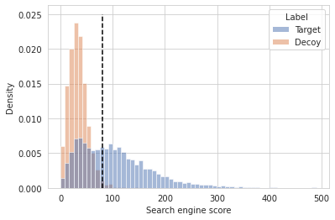
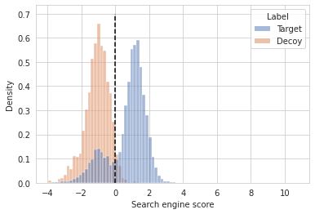
Machine learning-based information can be passed to Percolator for improved rescoring
Additional PSM information
Percolator
Notes:
One way to improve scoring functions through ML: rescoring

Slide 36

Machine learning-based information can be passed to Percolator for improved rescoring
Additional PSM information
Percolator

Slide 37



In challenging experimental workflows, machine learning can rescue peptide identification rates
ML
ML
Performant scoring function
Triangle of successful peptide identification
DIA
Complex samples
…
Proteogenomics
Metaproteomics
Immunopeptidomics
…
High quality spectra
Ideal search space

Slide 38
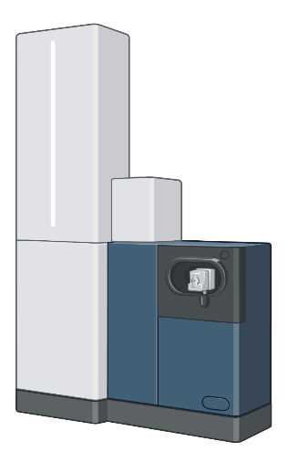
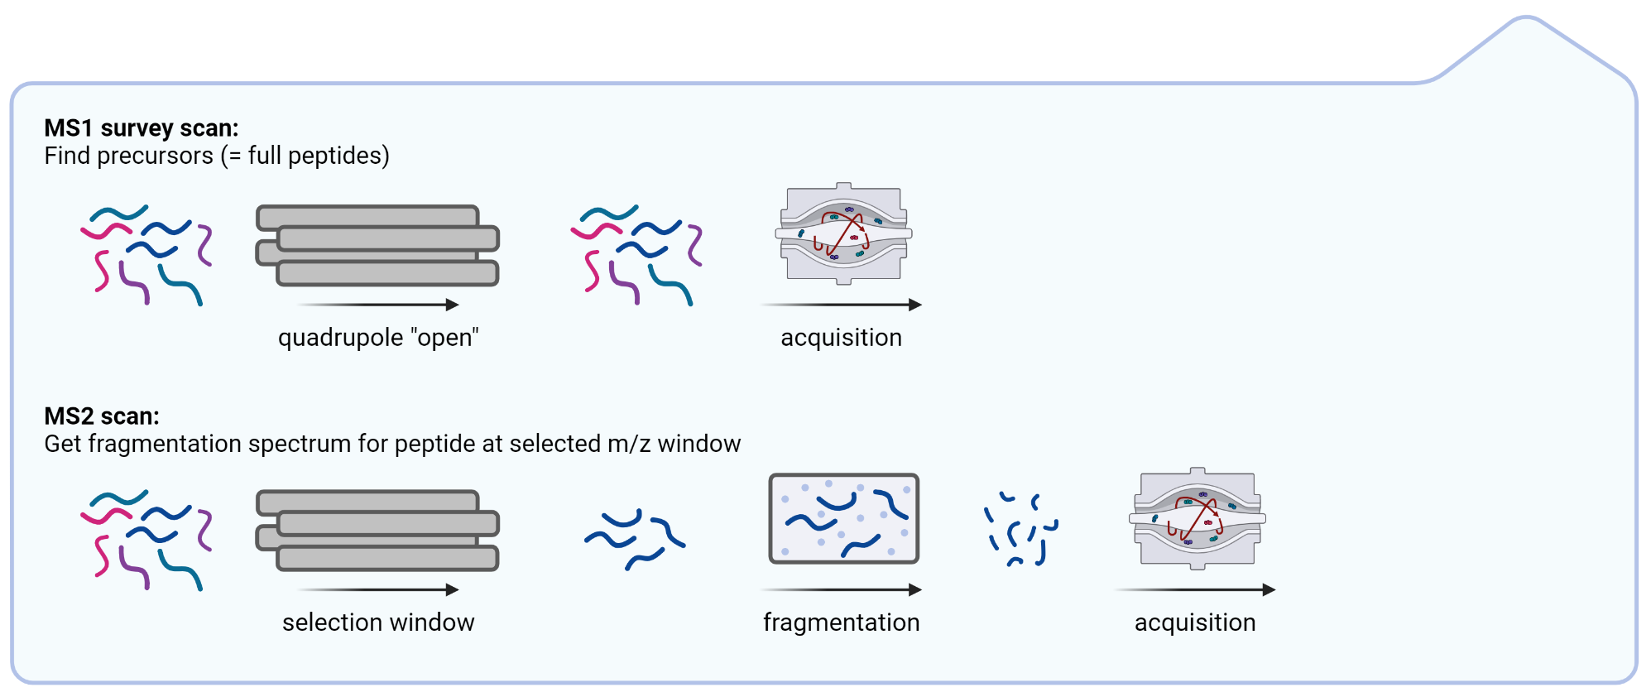
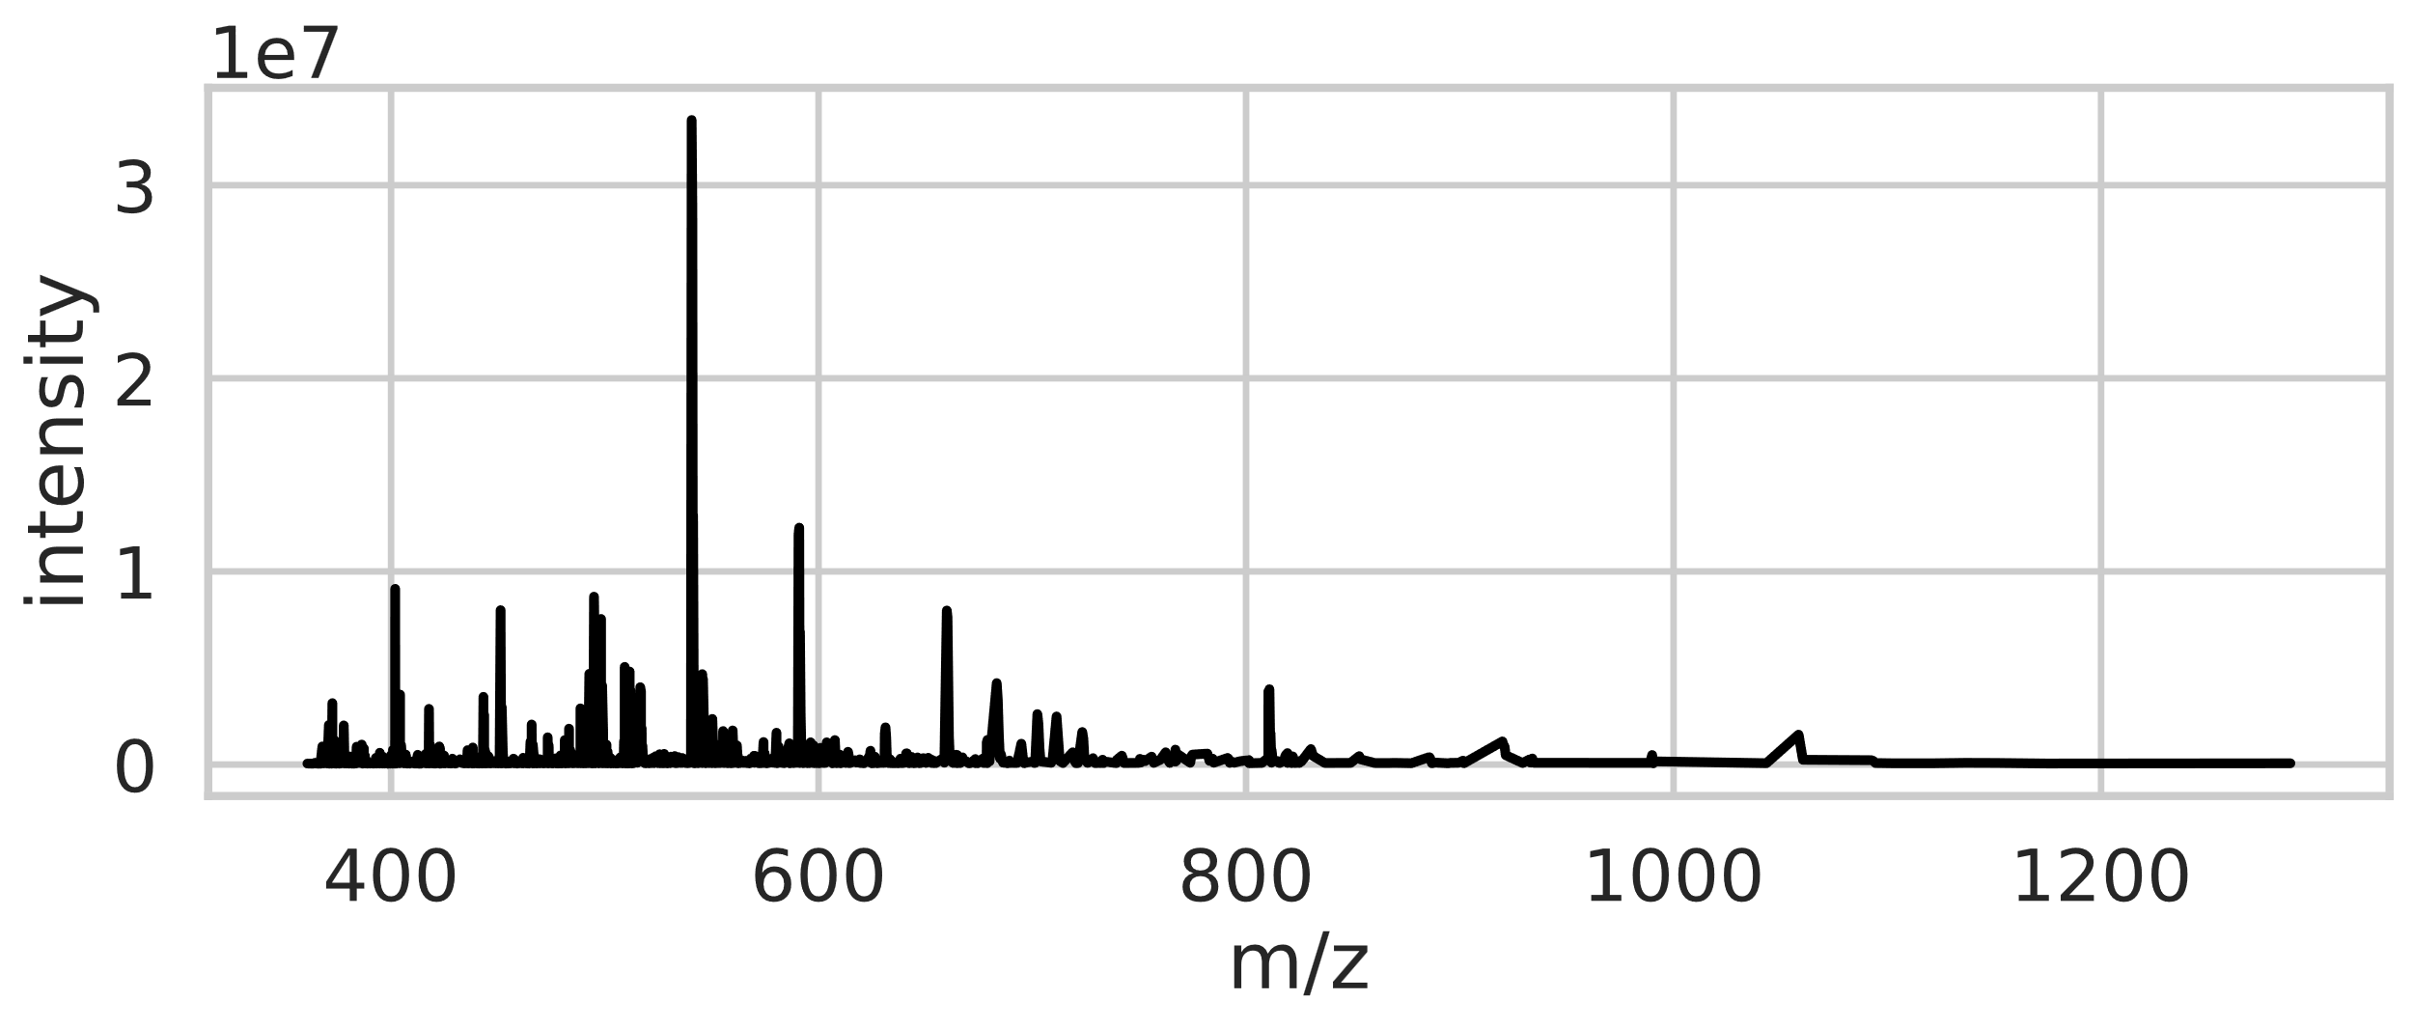

Mass spectrometry-based proteomics recap

Slide 39









How do we link MS2 spectra back to the original proteins?

Slide 40







Search engines return a set of peptide identifications that might be true

